Slide 1
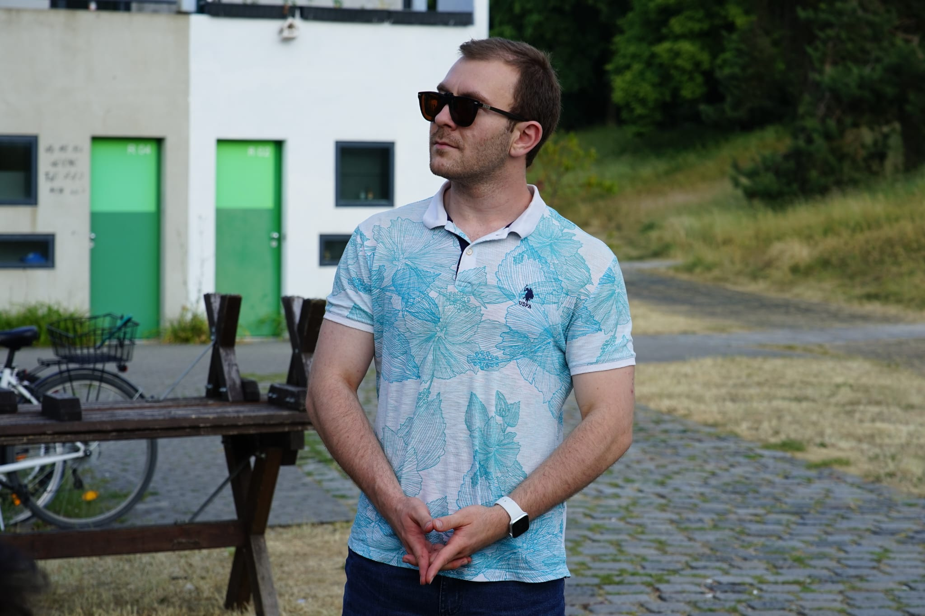

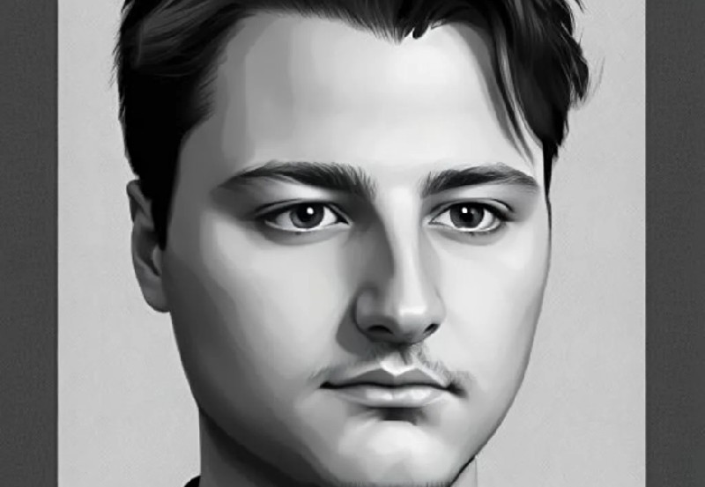
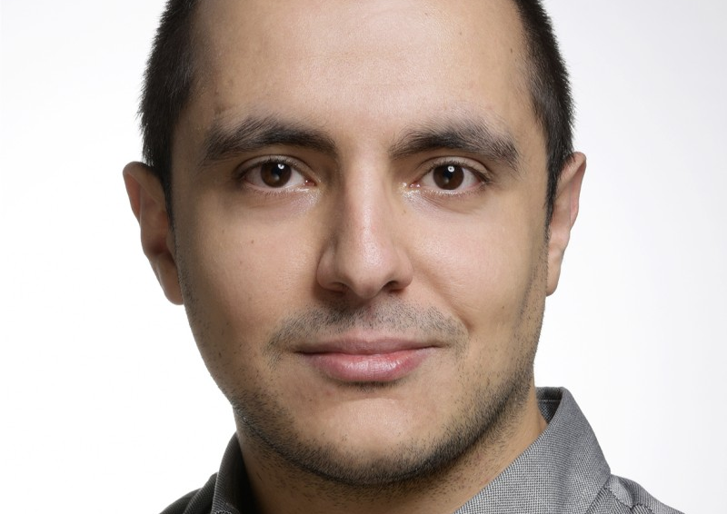
Team 8: Tetris with Hand-Gestures
Oguzhan Cesur,
Ozan Tanriverdi,
Sarp Cagin Erdogan,
Turker Han

Slide 2
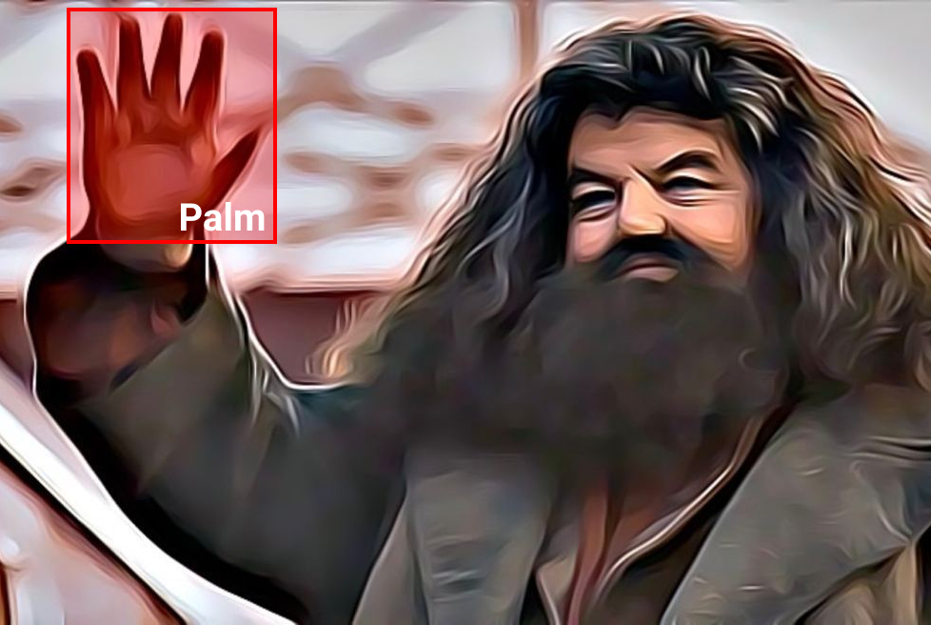
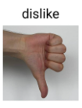
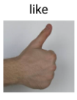
The Design Decisions
Compromise between available datasets and hand gesture which seem suitable for Tetris
HaGRID - HAnd Gesture Recognition Image Dataset
716GB, 552,992 FullHD RGB Images divided into 18 classes
"bboxes", "landmarks", "labels", "leading_hand"
Chosen gestures for the game:
“like”, “dislike”, “thumbs-up-left”, “thumbs-up-right”

Slide 3
Model Design
Object Detection
Landmark Regression
Gesture Classification

Slide 4
Challenges of the Project
Real-time gameplay → low inference time is a must
Dealing with the huge amount of data:
Being cautious with the planned pre-processing steps
Optimal use of the data set
Connecting the three models with each other
Avoiding the same move to be registered for multiple time windows
Initial Idea: Two classes for the moves: number gestures and action gestures
→ Drawback: Less fluent gameplay
2 of the selected gestures not available in the dataset

Slide 5
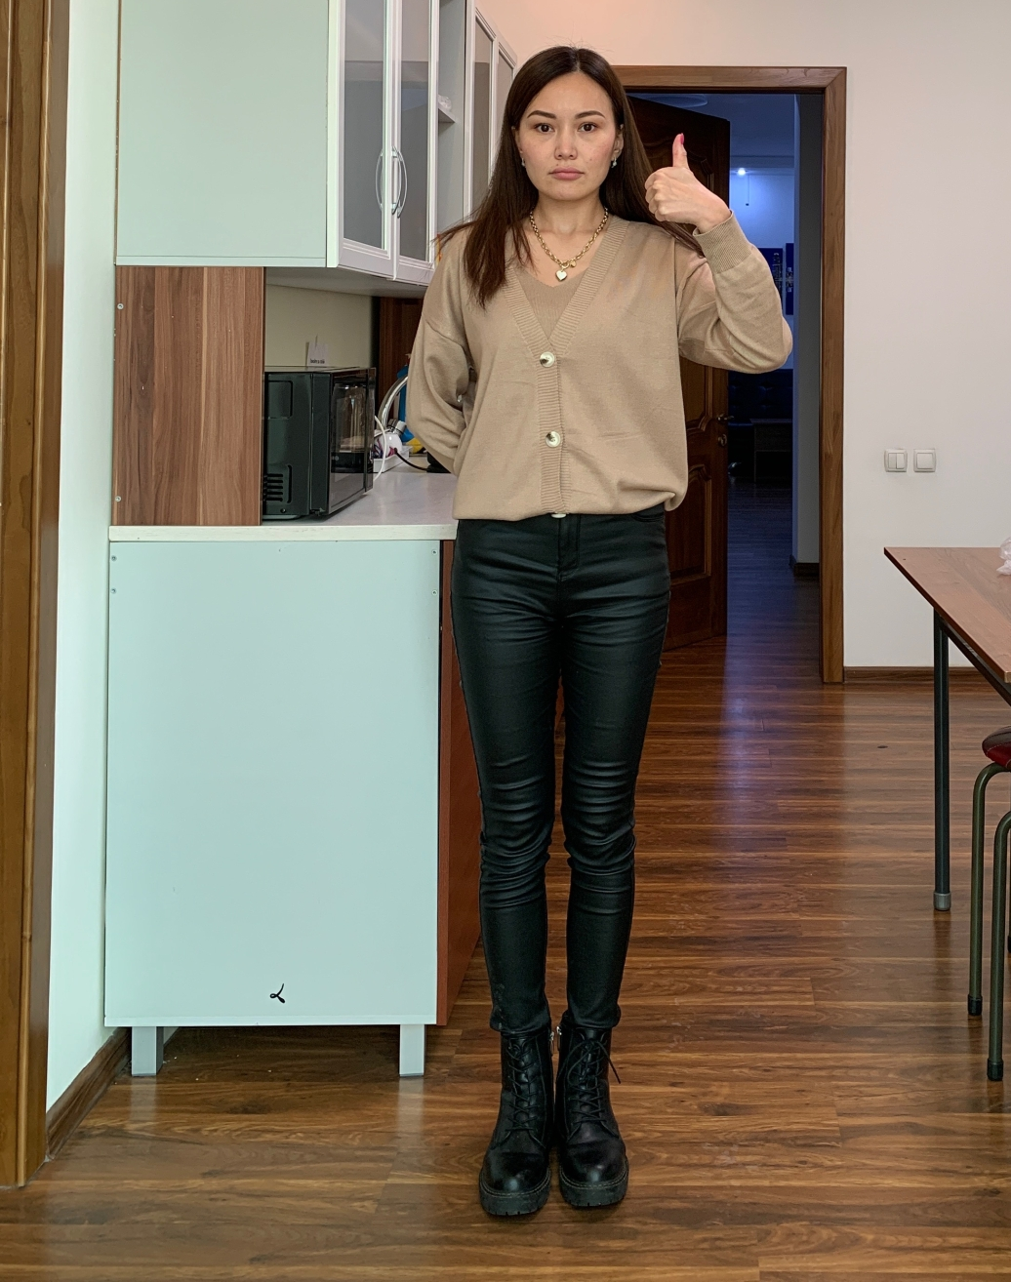
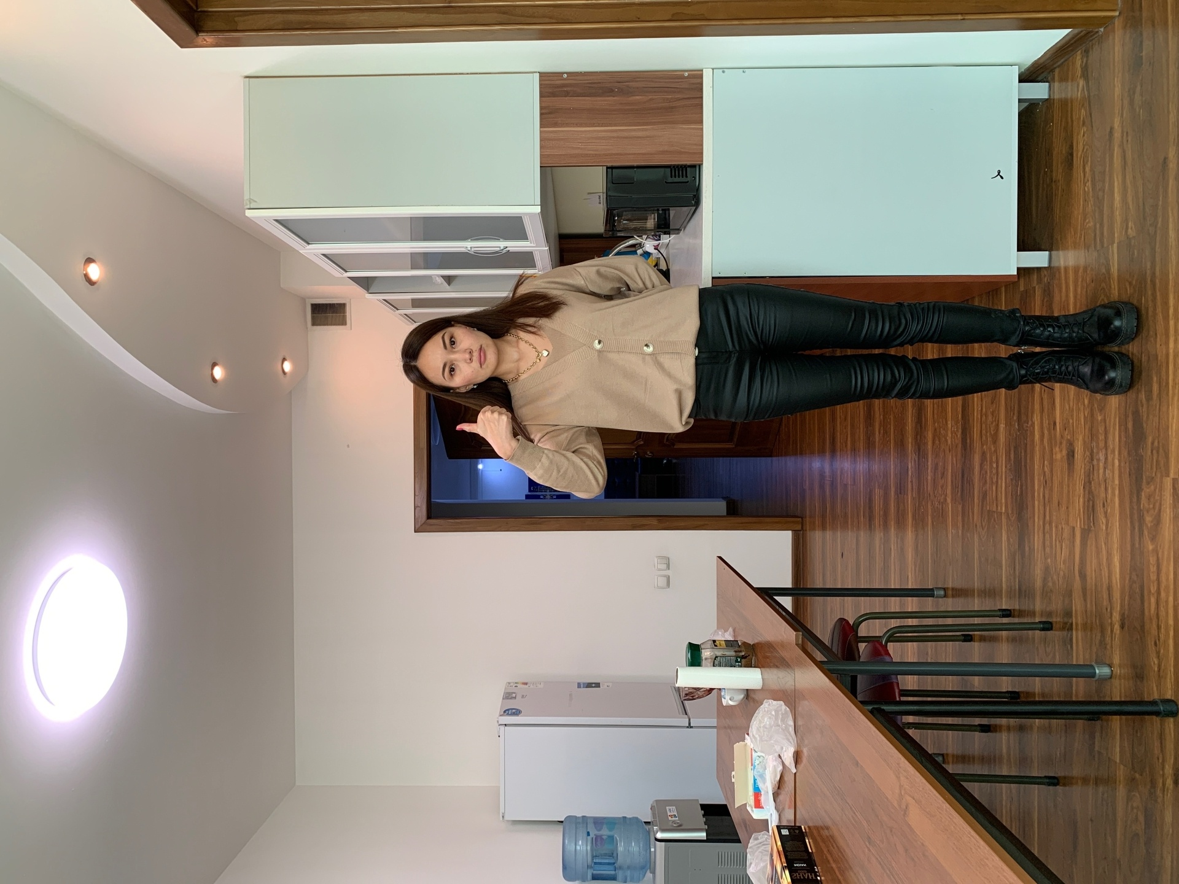
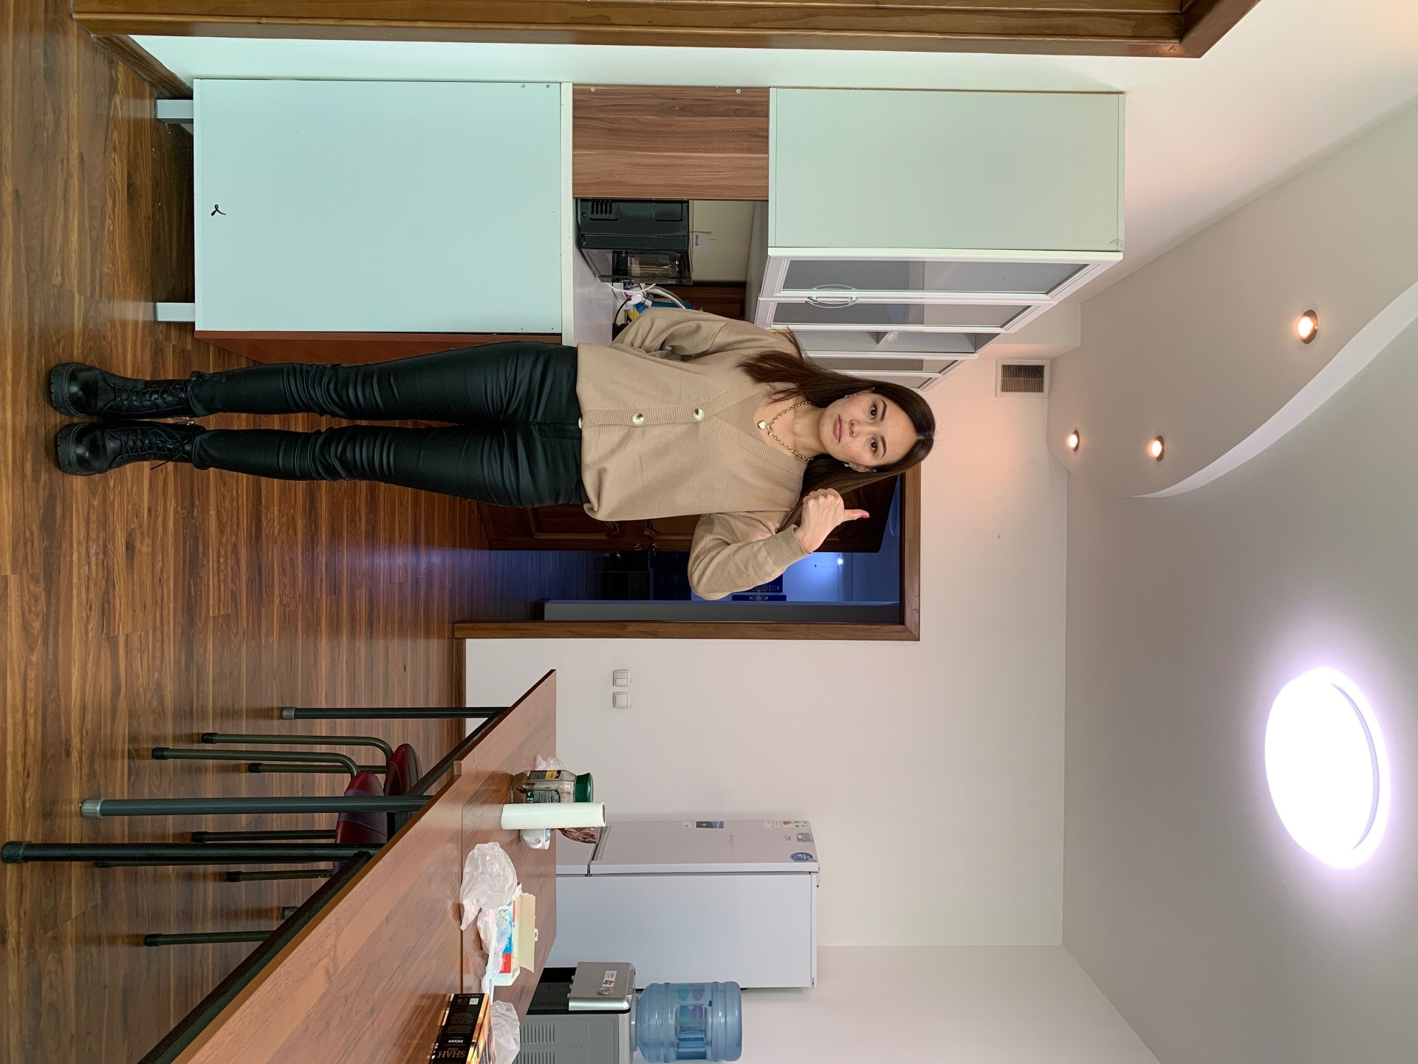
Pre-Processing

Slide 6
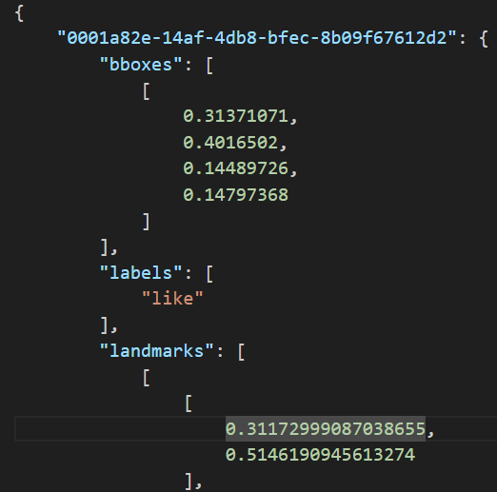
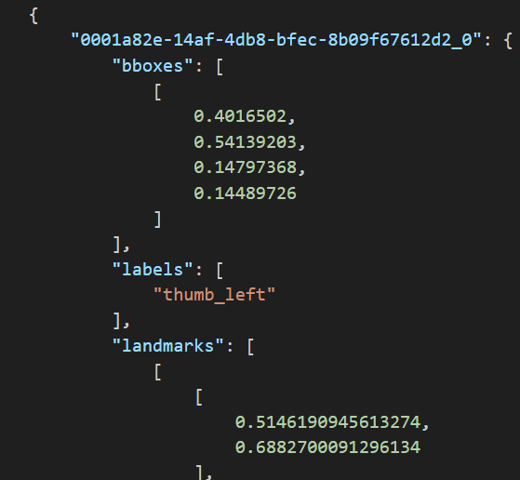

Slide 7
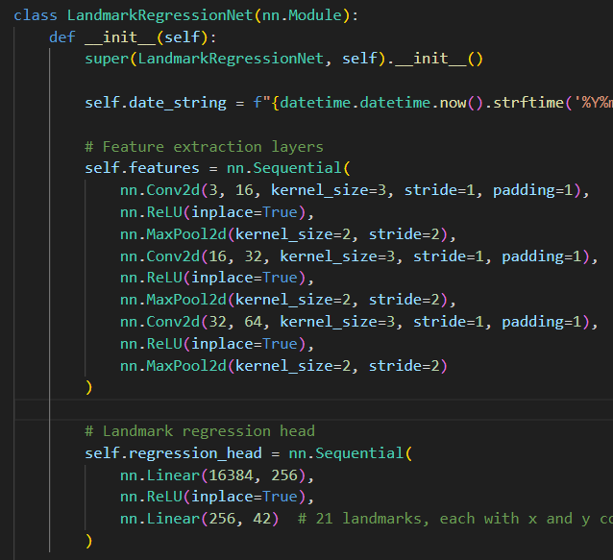
Models
1) Object (Hand) Detection
yolov8n – model (not pre-trained)
2) Landmark Regression
Feature Extraction: CNN with Max-Pooling layers
Regression Head: Linear Layers
Returns the landmark coordinates
3) Gesture Classification
Small network with only linear layers
Softmax at the end for the probabilities
Mapping to the list of gestures

Slide 8
Model Training & Testing
Training
Preparing the training dataset as a single directory and a single annotation (.json) file
Training the models separately on the same training data
Testing
Testing each model separately
After the implementation of the whole inference pipeline → Gesture predictions for image inputs
Testing on camera inputs

Slide 9
Deployment
Incoming perfect drawing on the whiteboard

Slide 10
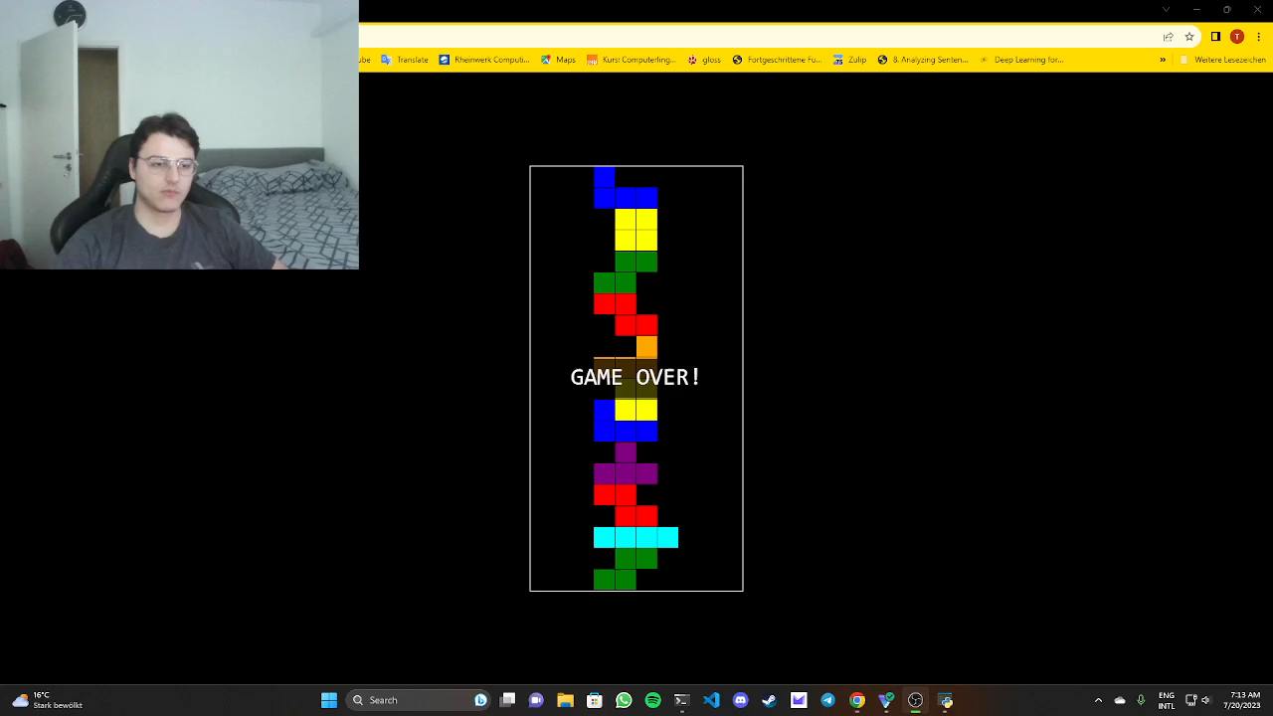
Project Demonstration

Slide 11
Lessons Learned & Moving Forward
Should have tested on a designated testing dataset
A more appealing frontend for the game
Exporting the model in Onnx format and integrating the model into the frontend to perform the inference on the client-side
→ Lower latency in the game
Shuffling the dataset in pre-processing (since the training dataset was created by concatenating the gesture datasets)
Rule-based gesture classification from landmarks for comparison

Slide 12
Sources
https://www.kaggle.com/datasets/kapitanov/hagrid
https://docs.ultralytics.com/modes/
https://www.freecodecamp.org/news/how-to-detect-objects-in-images-using-yolov8/
https://pytorch.org/docs/stable/index.html
https://pytorch.org/tutorials/intermediate/flask_rest_api_tutorial.html
https://pytorch.org/tutorials/beginner/blitz/neural_networks_tutorial.html
https://blog.paperspace.com/how-to-implement-a-yolo-object-detector-in-pytorch/

Slide 13
Q&A
Thanks for your attention
Any questions?

